Slide 1
Linux内核最新进展
海航云资深架构师张健

Slide 2

Outline
Who am I
Who writes the Linux kernel
Live with upstream kernel
Architecture relative features
Memory features
Staging features: ILP32

Slide 3

Who I am?
Linux kernel developer
Distributed storage developer
Open source lover
Wechat public account: 敏达生活
Notes:
TODO 添加共享的社区

Slide 4
Live with upstream kernel
Why
Minimize migration effort
E.g. migrate from kernel 4.4(16.04) to kernel 4.15(18.04) after three years LTS.
Collaborate with community
What
Feature
Pull request
Commit message
Code
Notes:
Mailing list
Conference

Slide 5
Live with upstream kernel
How
Website
Mailing list
IRC(e.g. irccloud)
Conference
Notes:
Mailing list
Conference

Slide 6
Live with upstream kernel: How
kernel newbie: https://kernelnewbies.org/Linux_4.16
LWN: merge window
4.16 Part1: https://lwn.net/Articles/746129/
4.16 Part2: https://lwn.net/Articles/746791/
4.17 Part1: https://lwn.net/Articles/750928/
4.17 Part2: https://lwn.net/Articles/751482/

Slide 7
Who writes the Linux kernel?

Slide 8
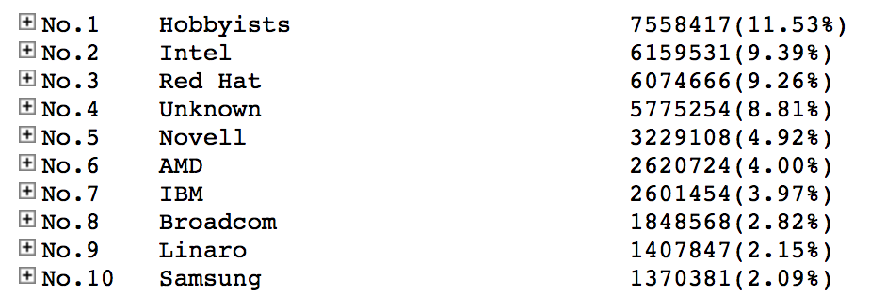
Who writes the Linux kernel
ref: http://www.remword.com/kps_result/all_whole_line.htm

Slide 9
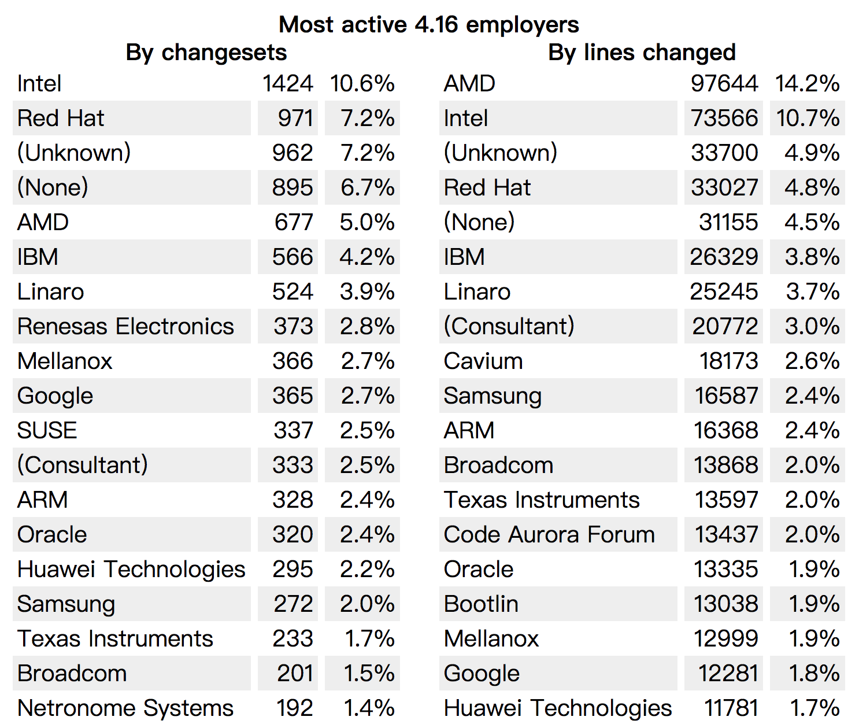
Who writes the Linux kernel
ref: https://lwn.net/Articles/750054/

Slide 10
Meltdown and Spectre
ISA and side-channel attack
Ref: google I/O 1’31’’: https://mp.weixin.qq.com/s/bUVQVk3W6BM4WNNbFnJ4HQ
Upstream status
Addressing Meltdown and Spectre in the kernel: https://lwn.net/Articles/743265/
Meltdown/Spectre mitigation for 4.15 and beyond: https://lwn.net/Articles/744287/
Meltdown and Spectre mitigations — a February update: https://lwn.net/Articles/746551/
Variant4: https://bugs.chromium.org/p/project-zero/issues/detail?id=1528&from=timeline
From google project zero as well

Slide 11
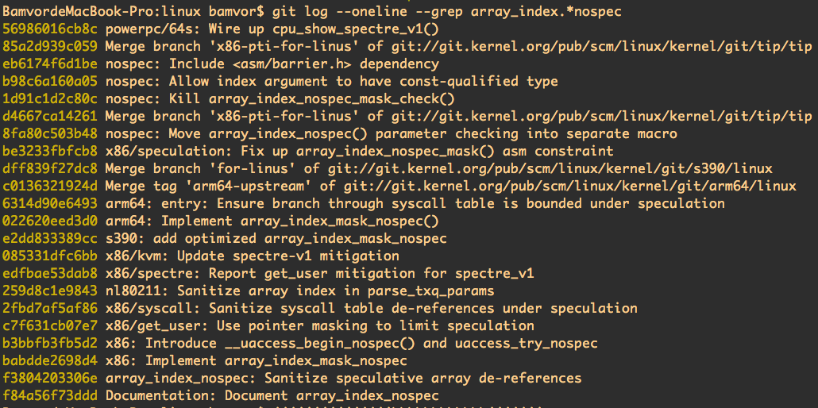
Spectre vulnerability(variant 1): "bounds-check bypass"

Slide 12
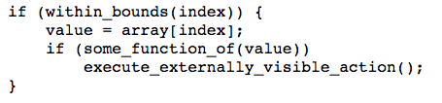
Spectre vulnerability(variant 1): "bounds-check bypass” cont

Slide 13
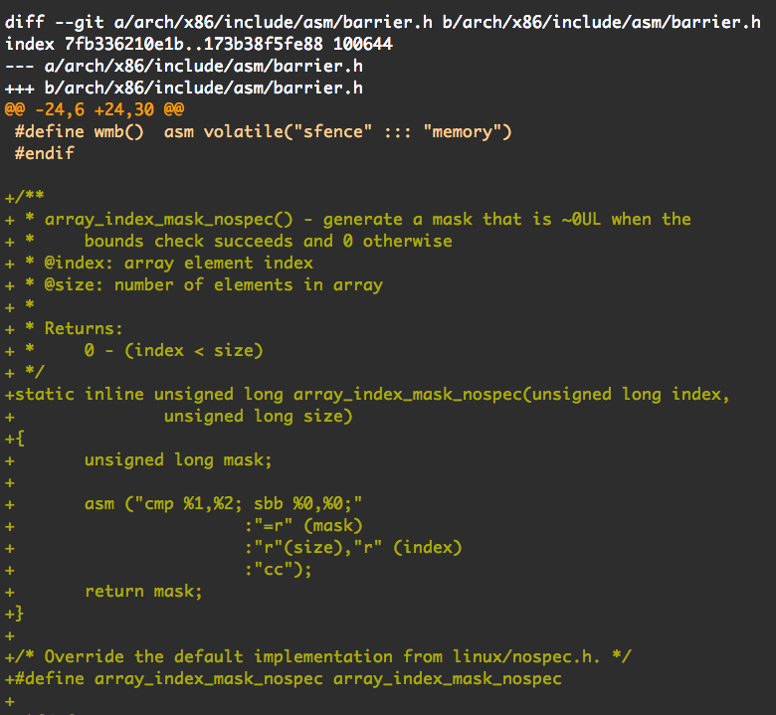
git show babdde2698d4
SBB: Integer Subtraction with Borrow. ref: https://c9x.me/x86/html/file_module_x86_id_286.html

Slide 14
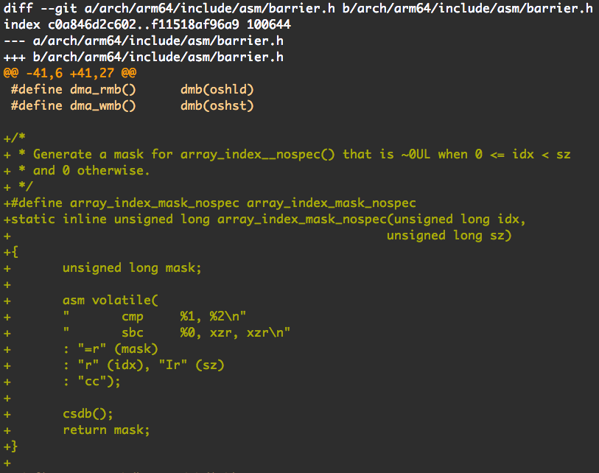
Spectre vulnerability(variant 1): “bounds-check bypass” cont(arm64)
git show 022620eed3d0
Arm armv8 C6-661:
SBC: Subtract with Carry subtracts a register vaue and the value of NOT (Carry flag) from a register value, and writes the result to the destination register

Slide 15
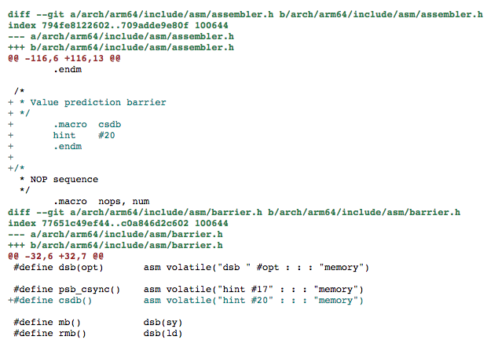
Spectre vulnerability(variant 1): “bounds-check bypass” cont(arm64)
https://patchwork.kernel.org/patch/10200747/
“For CPUs capable of data value prediction, CSDB waits for any outstanding predictions to architecturally resolve before allowing speculative execution to continue. Provide macros to expose it to the arch code.”

Slide 16
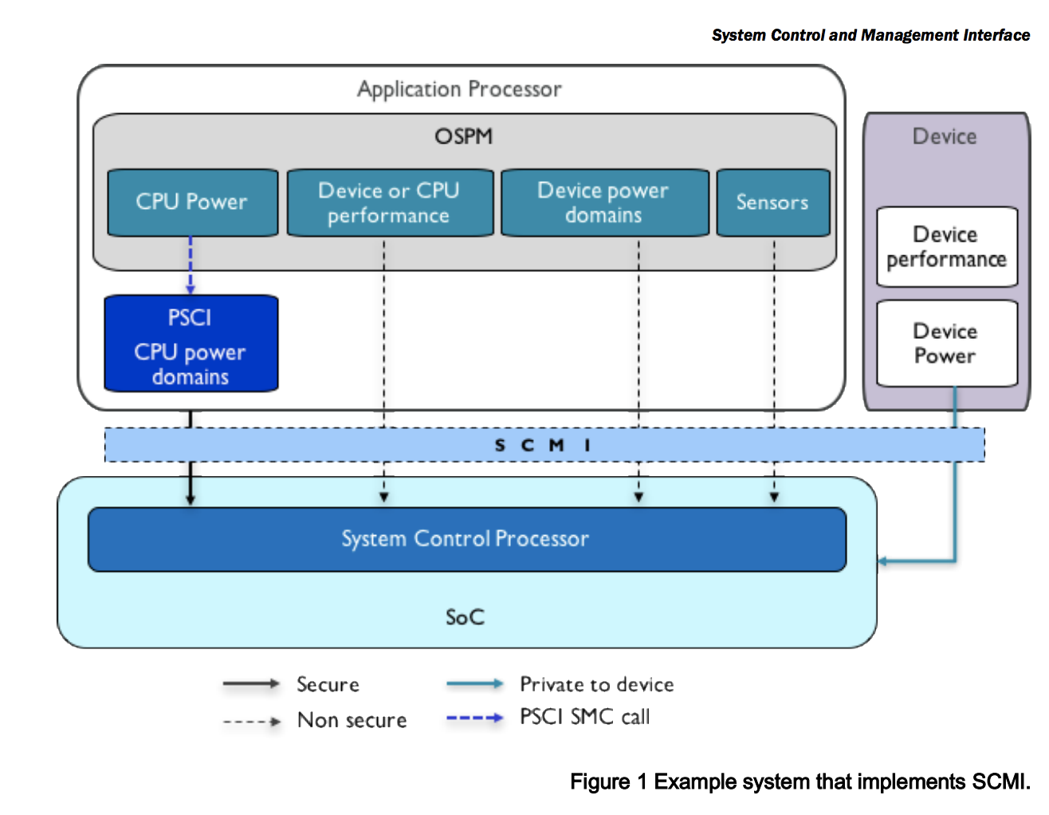
SCMI: ARM System Control and Management Interface
Ref:
http://infocenter.arm.com/help/index.jsp?topic=/com.arm.doc.den0056a/index.html

Slide 17
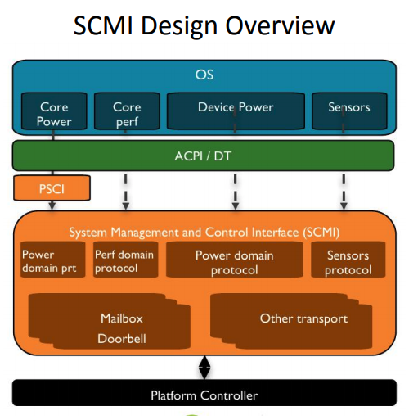
Ref:
https://www.linuxplumbersconf.org/2017/ocw/system/presentations/4759/original/fast_dvfs_scmi.pdf

Slide 18
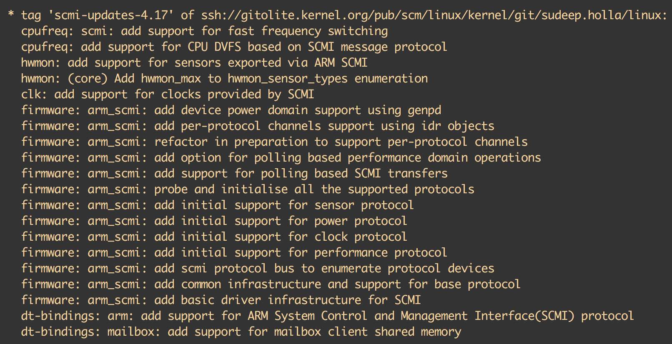
SCMI: ARM System Control and Management Interface
Ref: git log f46f11dc1e86270935041fbc3920ba71a050a5fd^!

Slide 19
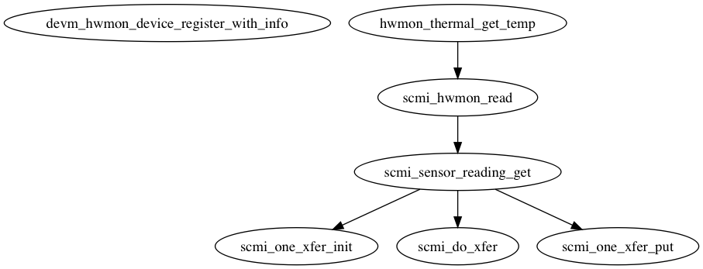
SCMI: ARM System Control and Management Interface

Slide 20
Memory encryption: Intel SGX
Ref: https://medium.com/@danny_harnik/impressions-of-intel-sgx-performance-22442093595a

Slide 21
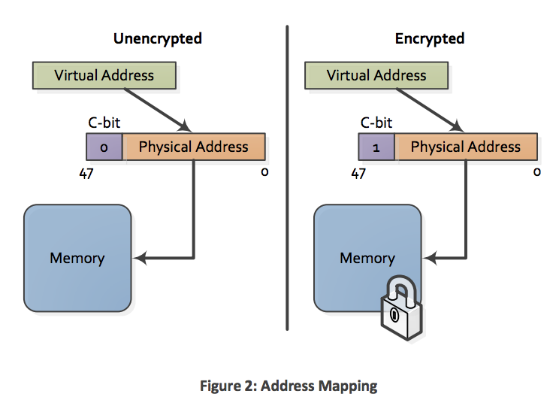
Memory encryption: AMD SEV
Ref: http://amd-dev.wpengine.netdna-cdn.com/wordpress/media/2013/12/AMD_Memory_Encryption_Whitepaper_v7-Public.pdf

Slide 22
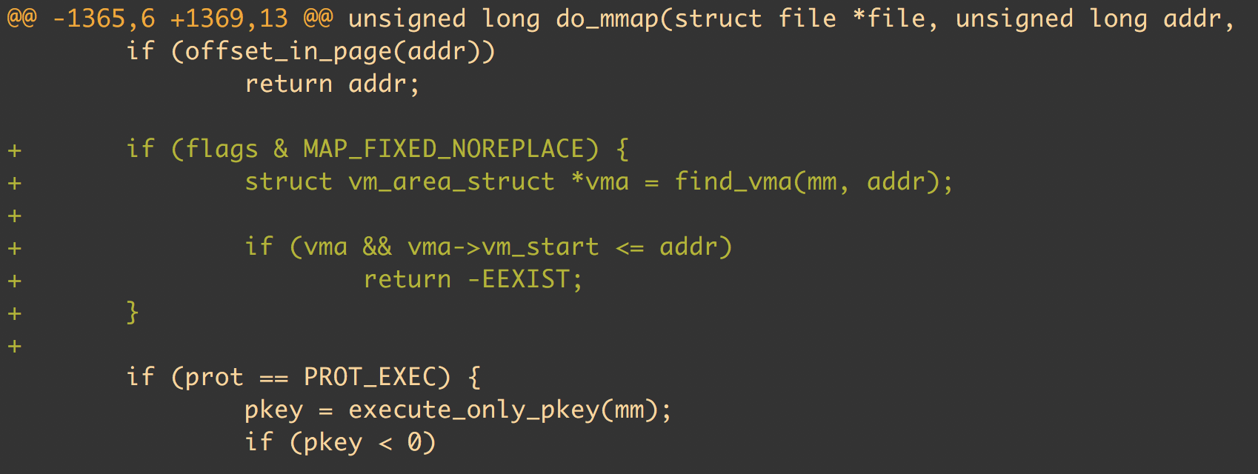
Memory: Introduce MAP_FIXED_NOREPLACE
git log --oneline --grep MAP_FIXED_NOREPLACE
Commit: a4ff8e8620d3 mm: introduce MAP_FIXED_NOREPLACE

Slide 23
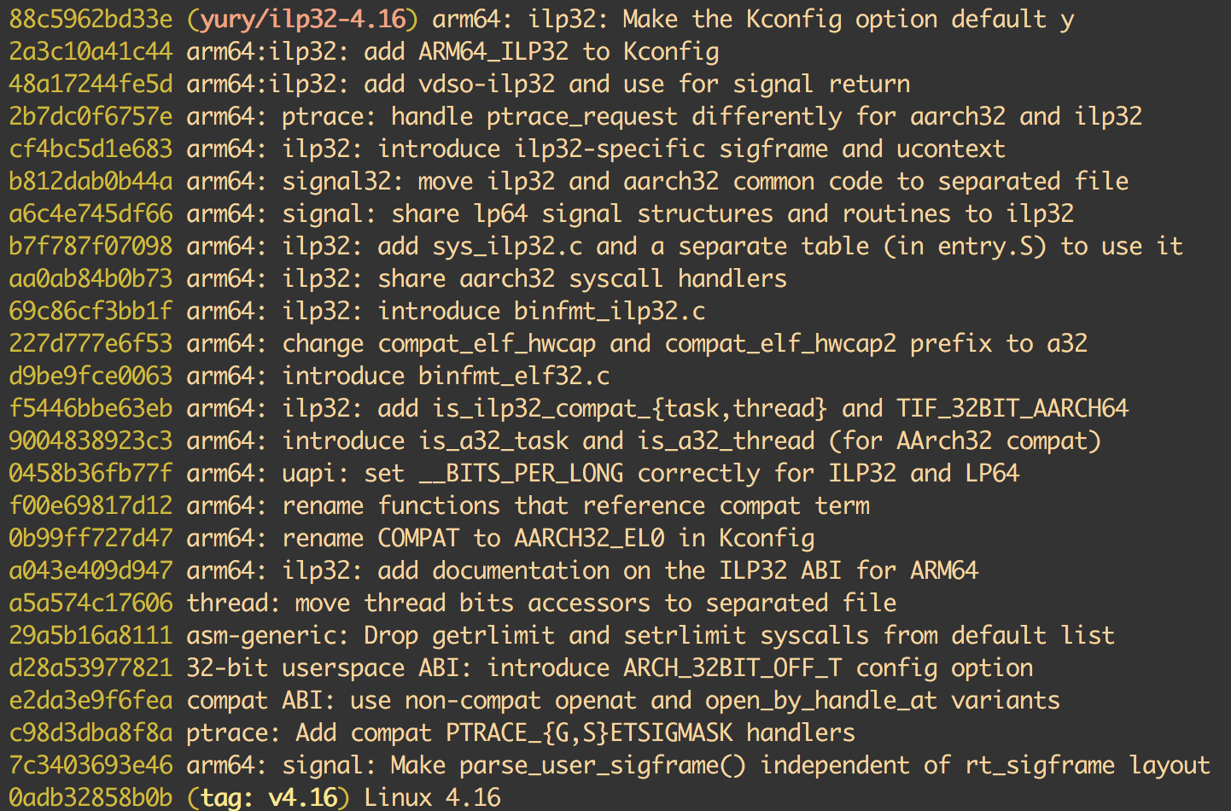
Staging features: ILP32
Ref: https://github.com/norov/linux/tree/ilp32-4.16

Slide 24
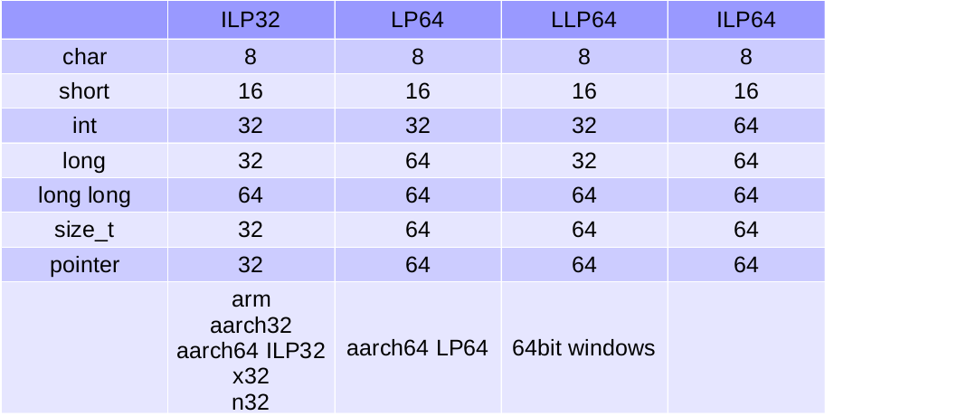
Staging features: ILP32

Slide 25
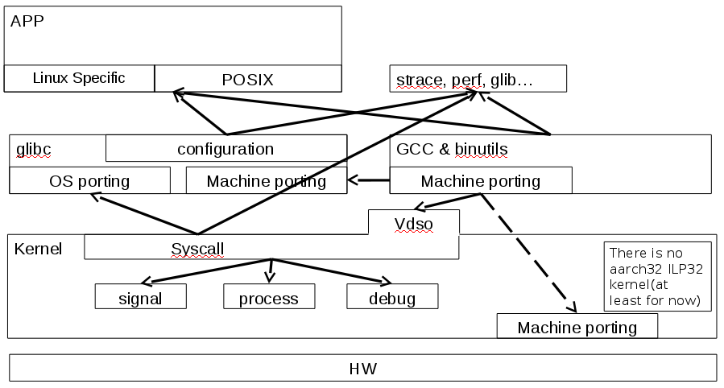
Staging features: ILP32

Slide 26
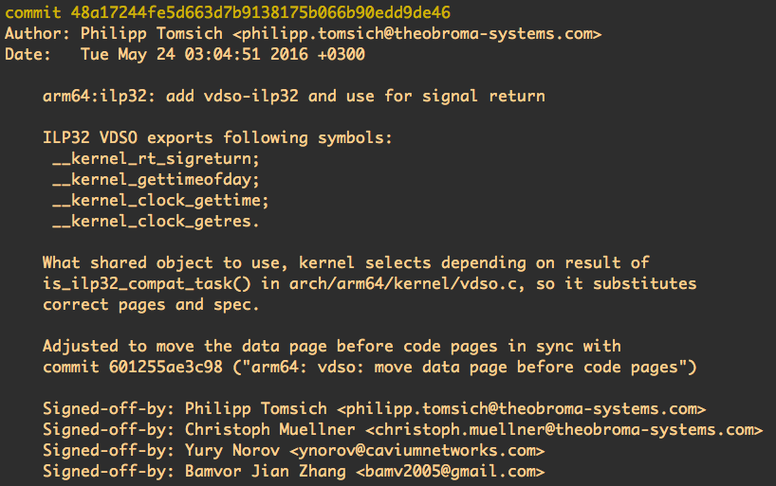
Staging features: ILP32

Slide 27
Thanks
半瓦平时有随手记笔记的习惯，公众号《敏达生活》。只分享自己有体会的信息，希望能促进价值信息流动。任何建议欢迎给我留言或添加我的微信：
春风吹又生—-梳理中国CPU
Linux自动化部署工具综述（Linux自动化部署工具系列之一）
比较操作系统镜像制作方式（Linux自动化部署工具系列之二）
ARM生态系统的盛会Linaro connect（之一）：arm64 server和端侧AI
ARM生态系统的盛会Linaro connect（之二）：arm64 workstation和低成本调试工具
内核测试小整理

